Slide 1
React JS
Do / DON’T
Ben Khalfallah Héla

Slide 2
Ce que nous allons voir …
Patterns
Anti-Patterns
Pourquoi ?

Slide 3
Tout est une question de trade-offs (compromis)
Maintenabilité
Performances
Efficacité

Slide 4
Taille des composants

Slide 5
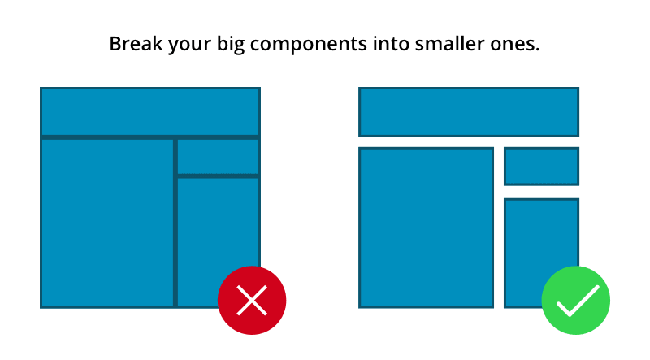
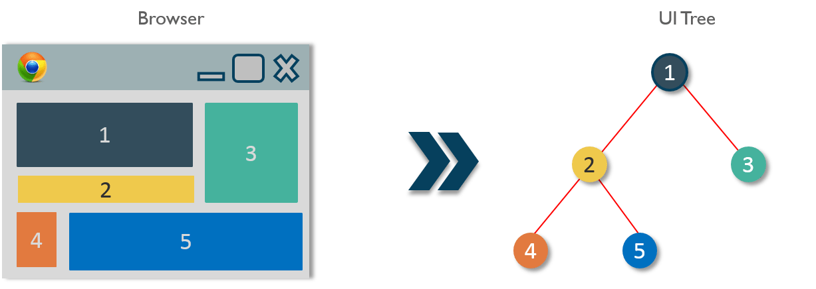
Taille des composants
Dont’: Grands Composants.
Do: Composition, Abstraction Progressive.

Slide 6
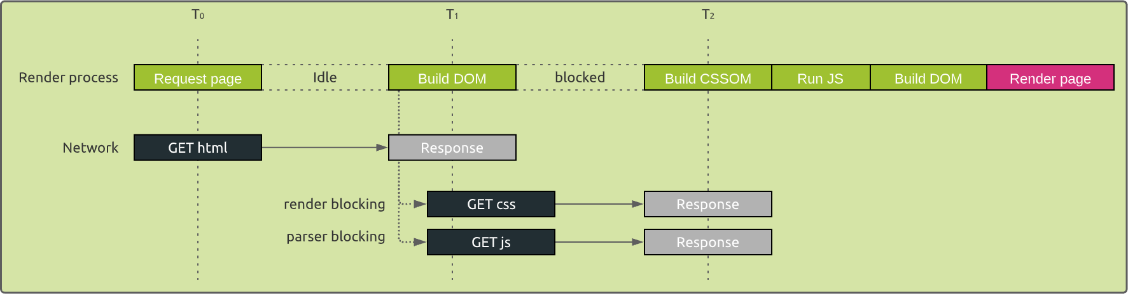
Critical Rendering Path

Slide 7
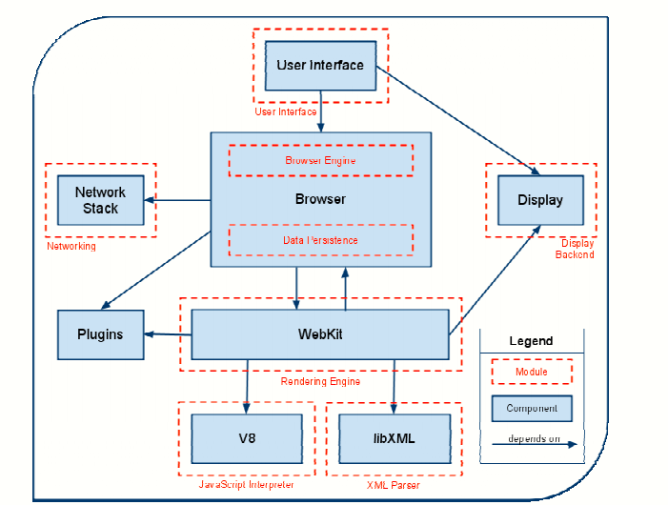
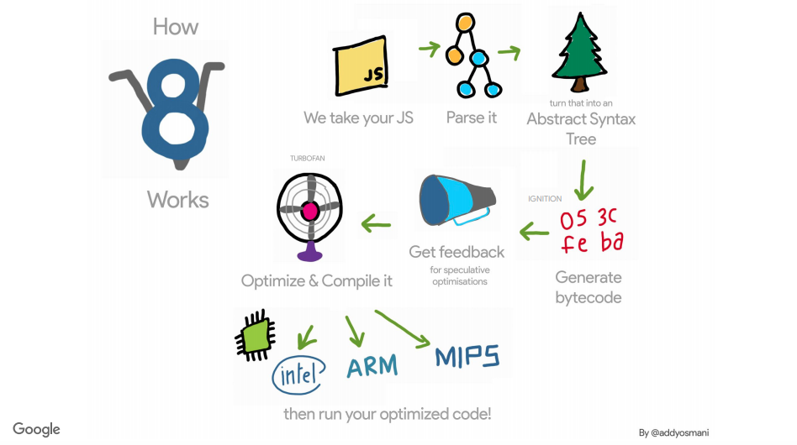
Architecture de chrome
V8: Just In Time

Slide 8
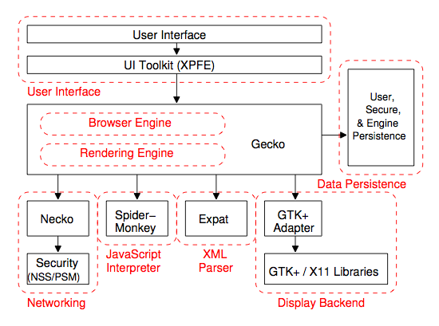
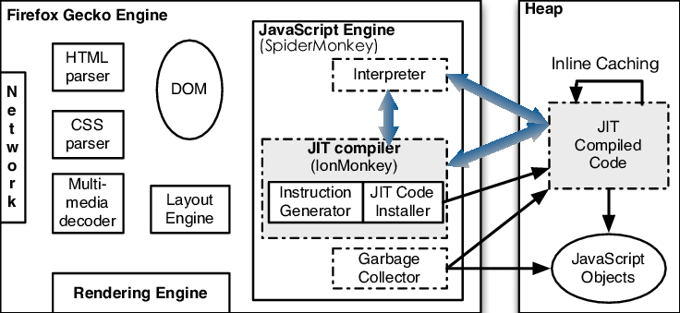
Architecture de firefox
Spider Monkey: Just In Time

Slide 9
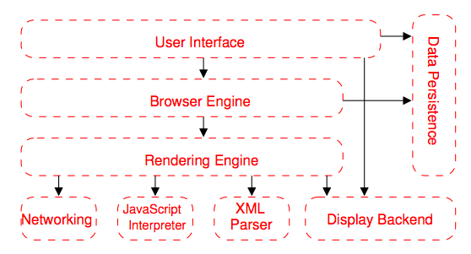
Architecture généralisée d’un browser

Slide 10
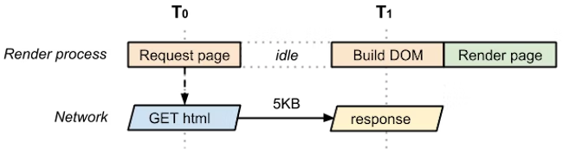
Rendering d’une page html simple
<!DOCTYPE html> <html> <head> <meta name="viewport" content="width=device-width,initial-scale=1" /> <title>Critical Path: No Style</title> </head> <body> <p>Hello <span>web performance</span> students!</p> </body> </html>

Slide 11
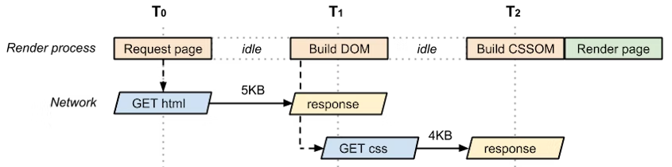
Ajout d’un css
Nous avons besoin à la fois du HTML et du CSS pour construire la page. En conséquence, HTML et CSS sont des ressources critiques: le CSS n'est récupéré qu'après que le navigateur a obtenu le document HTML.
<!DOCTYPE html> <html> <head> <meta name="viewport" content="width=device-width,initial-scale=1" /> <link href="style.css" rel="stylesheet" /> </head> <body> <p>Hello <span>web performance</span> students!</p> <div><img src="awesome-photo.jpg" /></div> </body> </html>
2 ressources critiques (html + css)
2 allers-retours ou plus pour la longueur minimale du chemin critique
ce qui fait 9 KB d'octets critiques

Slide 12
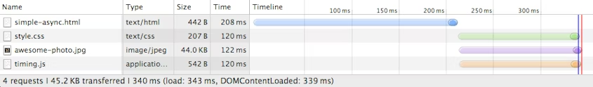
Ajout d’un script javascript
<!DOCTYPE html> <html> <head> <meta name="viewport" content="width=device-width,initial-scale=1" /> <link href="style.css" rel="stylesheet" /> </head> <body> <p>Hello <span>web performance</span> students!</p> <div><img src="awesome-photo.jpg" /></div> <script src="app.js"></script> </body> </html>
3 ressources critiques (html + css + js)
2 allers-retours ou plus pour la longueur minimale du chemin critique
ce qui fait 11 KB d'octets critiques

Slide 13
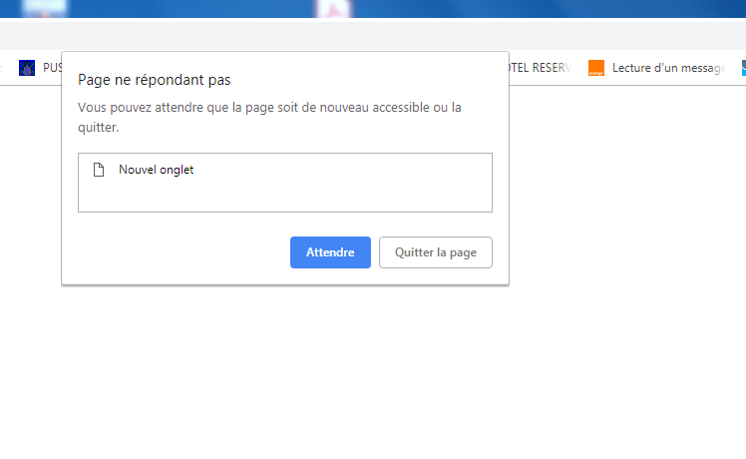
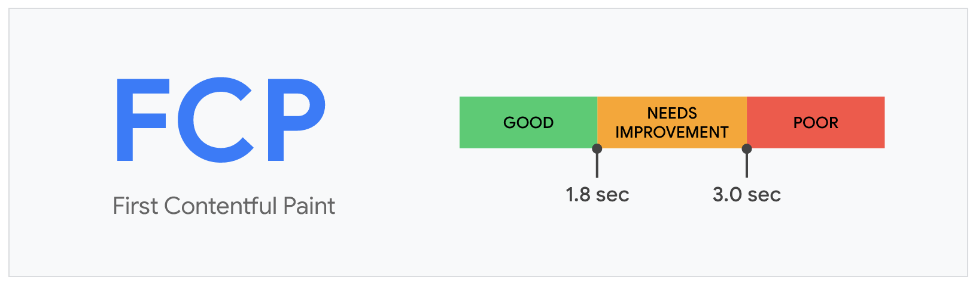
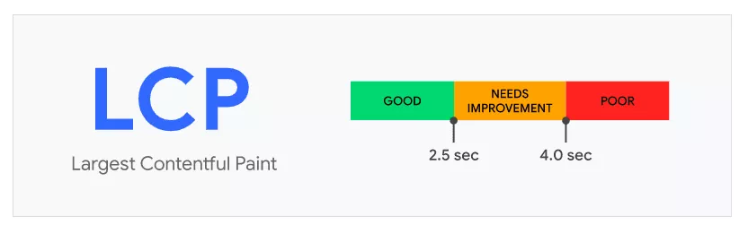
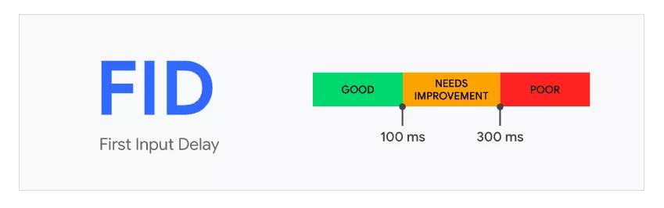
Impacts des grands composants
Mauvais score FCP
Mauvais score LCP
Mauvais score FID
Mainthread occupé et bloqué

Slide 14
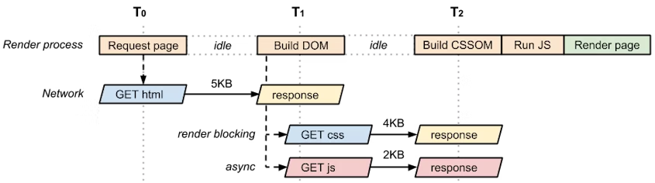
Chargement async du script javascript
<!DOCTYPE html> <html> <head> <meta name="viewport" content="width=device-width,initial-scale=1" /> <link href="style.css" rel="stylesheet" /> </head> <body> <p>Hello <span>web performance</span> students!</p> <div><img src="awesome-photo.jpg" /></div> <script src="app.js" async></script> </body> </html>
le script ne bloque plus l'analyseur et ne fait pas partie du chemin de rendu critique.
en conséquence, notre page optimisée est maintenant revenue à deux ressources critiques (HTML et CSS), avec une longueur de chemin critique minimale de deux allers-retours et un total de 9 Ko d'octets critiques.

Slide 15
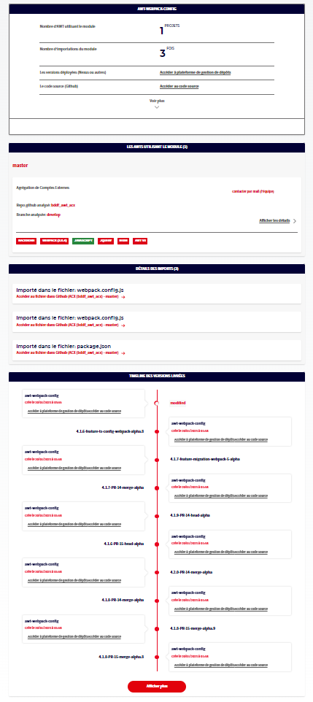
<> <HouseNpmInfosView npm={npm} /> <HouseNpmLibUsedOnView usedOnAwtsCount={npm?.usedOnAwtsCount} usedOnAwts={npm?.usedOnAwts} onOpenAwtDetailsClicked={onOpenAwtDetailsClicked} /> <HouseNpmLibImportedOnView importFiles={npm?.importFiles} importFilesCount={npm?.importFilesCount} /> <HouseNpmLibTimeline npm={npm} /> </>

Slide 16
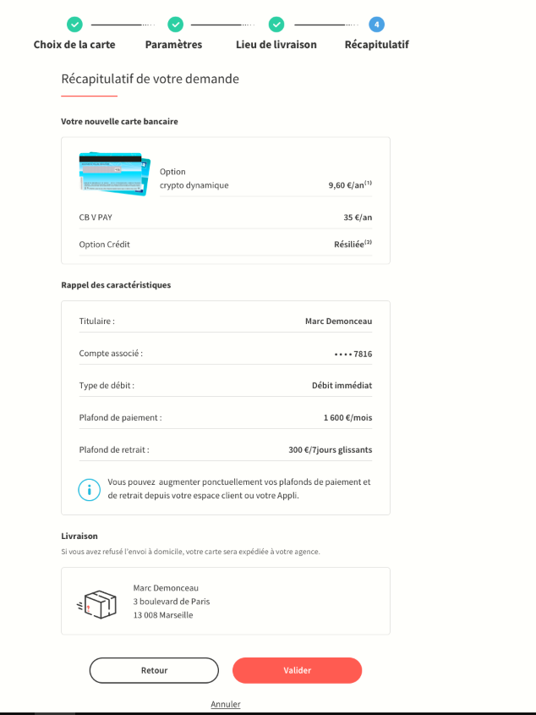
Atome SGStep
Atome SGTitle
Organism : NewCardView
SummaryView
Organism : CharacteristicsView
SummaryPage
Organism : DeliveryView
Molecule : EtapeFooter

Slide 17
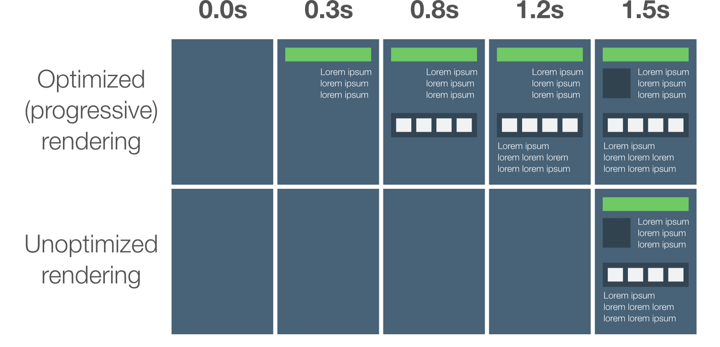
const HouseNpmInfosView = ( lazy(() => ( import('../npm-lib-infos/HouseNpmLibInfosView') )) ); const HouseNpmLibUsedOnView = ( lazy(() => ( import('../npm-lib-used-on/HouseNpmLibUsedOnView') )) ); const HouseNpmLibImportedOnView = ( lazy(() => ( import('../npm-lib-imported-on/HouseNpmLibImportedOnView') )) ); const HouseNpmLibTimeline = ( lazy(() => ( import('../npm-lib-timeline/HouseNpmLibTimeline') )) );
<Suspense fallback={<SGSpinner size="sm" />} > <> <HouseNpmInfosView npm={npm} /> <HouseNpmLibUsedOnView usedOnAwtsCount={npm?.usedOnAwtsCount} usedOnAwts={npm?.usedOnAwts} onOpenAwtDetailsClicked={onOpenAwtDetailsClicked} /> <HouseNpmLibImportedOnView importFiles={npm?.importFiles} importFilesCount={npm?.importFilesCount} /> <HouseNpmLibTimeline npm={npm} /> </> </Suspense>
Progressive rendering

Slide 18
<Suspense fallback={<SGSpinner size="sm" />} > <> {!hideSearchBar && ( <HouseSearchBar testpath="../app/commons/components/HouseSearchBar" defaultSearchText={defaultSearchText} onRechercheSimpleClicked={(searchText) => { setNpmSearchText(searchText); }} /> )} {(npmCurrentNumber > 0) && ( <HouseNpmLibListHeader testpath="../app/components/npm-lib/HouseNpmLibListHeader" defaultAlphabeticFilterText={npmAlphabeticFilterText} defaultSearchText={npmSearchText} npmCurrentNumber={npmCurrentNumber} /> )} {!npmSearchText && ( <HouseAlphabeticFilter defaultAlphabeticFilterText={npmAlphabeticFilterText} onAlphabeticFilterChanged={(filter) => { setNpmAlphabeticFilterText(filter); }} /> )}
Import & Load
On Visibility
const HouseSearchBar = ( lazy(() => ( import('../../../commons/components/HouseSearchBar') )) ); const HouseNpmLibListHeader = ( lazy(() => ( import('./HouseNpmLibListHeader') )) ); const HouseAlphabeticFilter = ( lazy(() => ( import('../../../commons/components/HouseAlphabeticFilter') )) );
https://www.patterns.dev/posts/import-on-visibility/

Slide 19
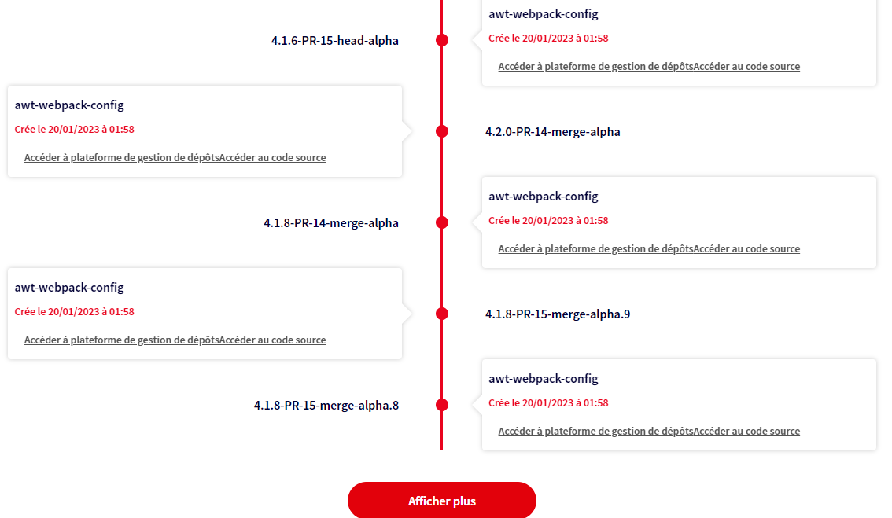
Import & Load
On Interaction
https://www.patterns.dev/posts/import-on-interaction/

Slide 20
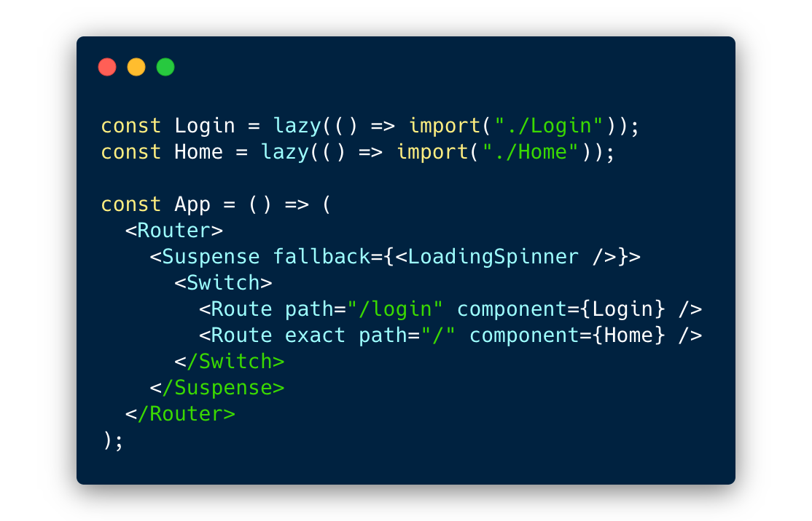
Route Based Splitting

Slide 21
Ce qu’on gagne de la composition
Routes & Code split via Suspense & lazy.
Amélioration des scores FCP, LCP, FID, …
Maintainability, Reusability, DRY, Scalability.
Mainthread concentré sur les choses les plus importantes ensuite le reste à la demande.

Slide 22
Attention
lazy doit être toujours utilisé avec Suspense (placeholder).
La loader est important pour marquer le chargement du composant (Optimistic UI).
Le passage par lazy et Suspense va créer automatiquement (sans aucune configuration supplémentaire) un chunck séparé pour le composant qui sera chargé à la demande et en parallèle.
Pour que webpack puisse bien splitter le bundle, il faut s'assurer que le composant n'est appelée qu'en lazy: il n'est pas importé d'une façon ordinaire ou référencé dans un index ou un fichier particulier (un import ordinaire + un import lazy => l'import ordinaire qui va l'importer).

Slide 23
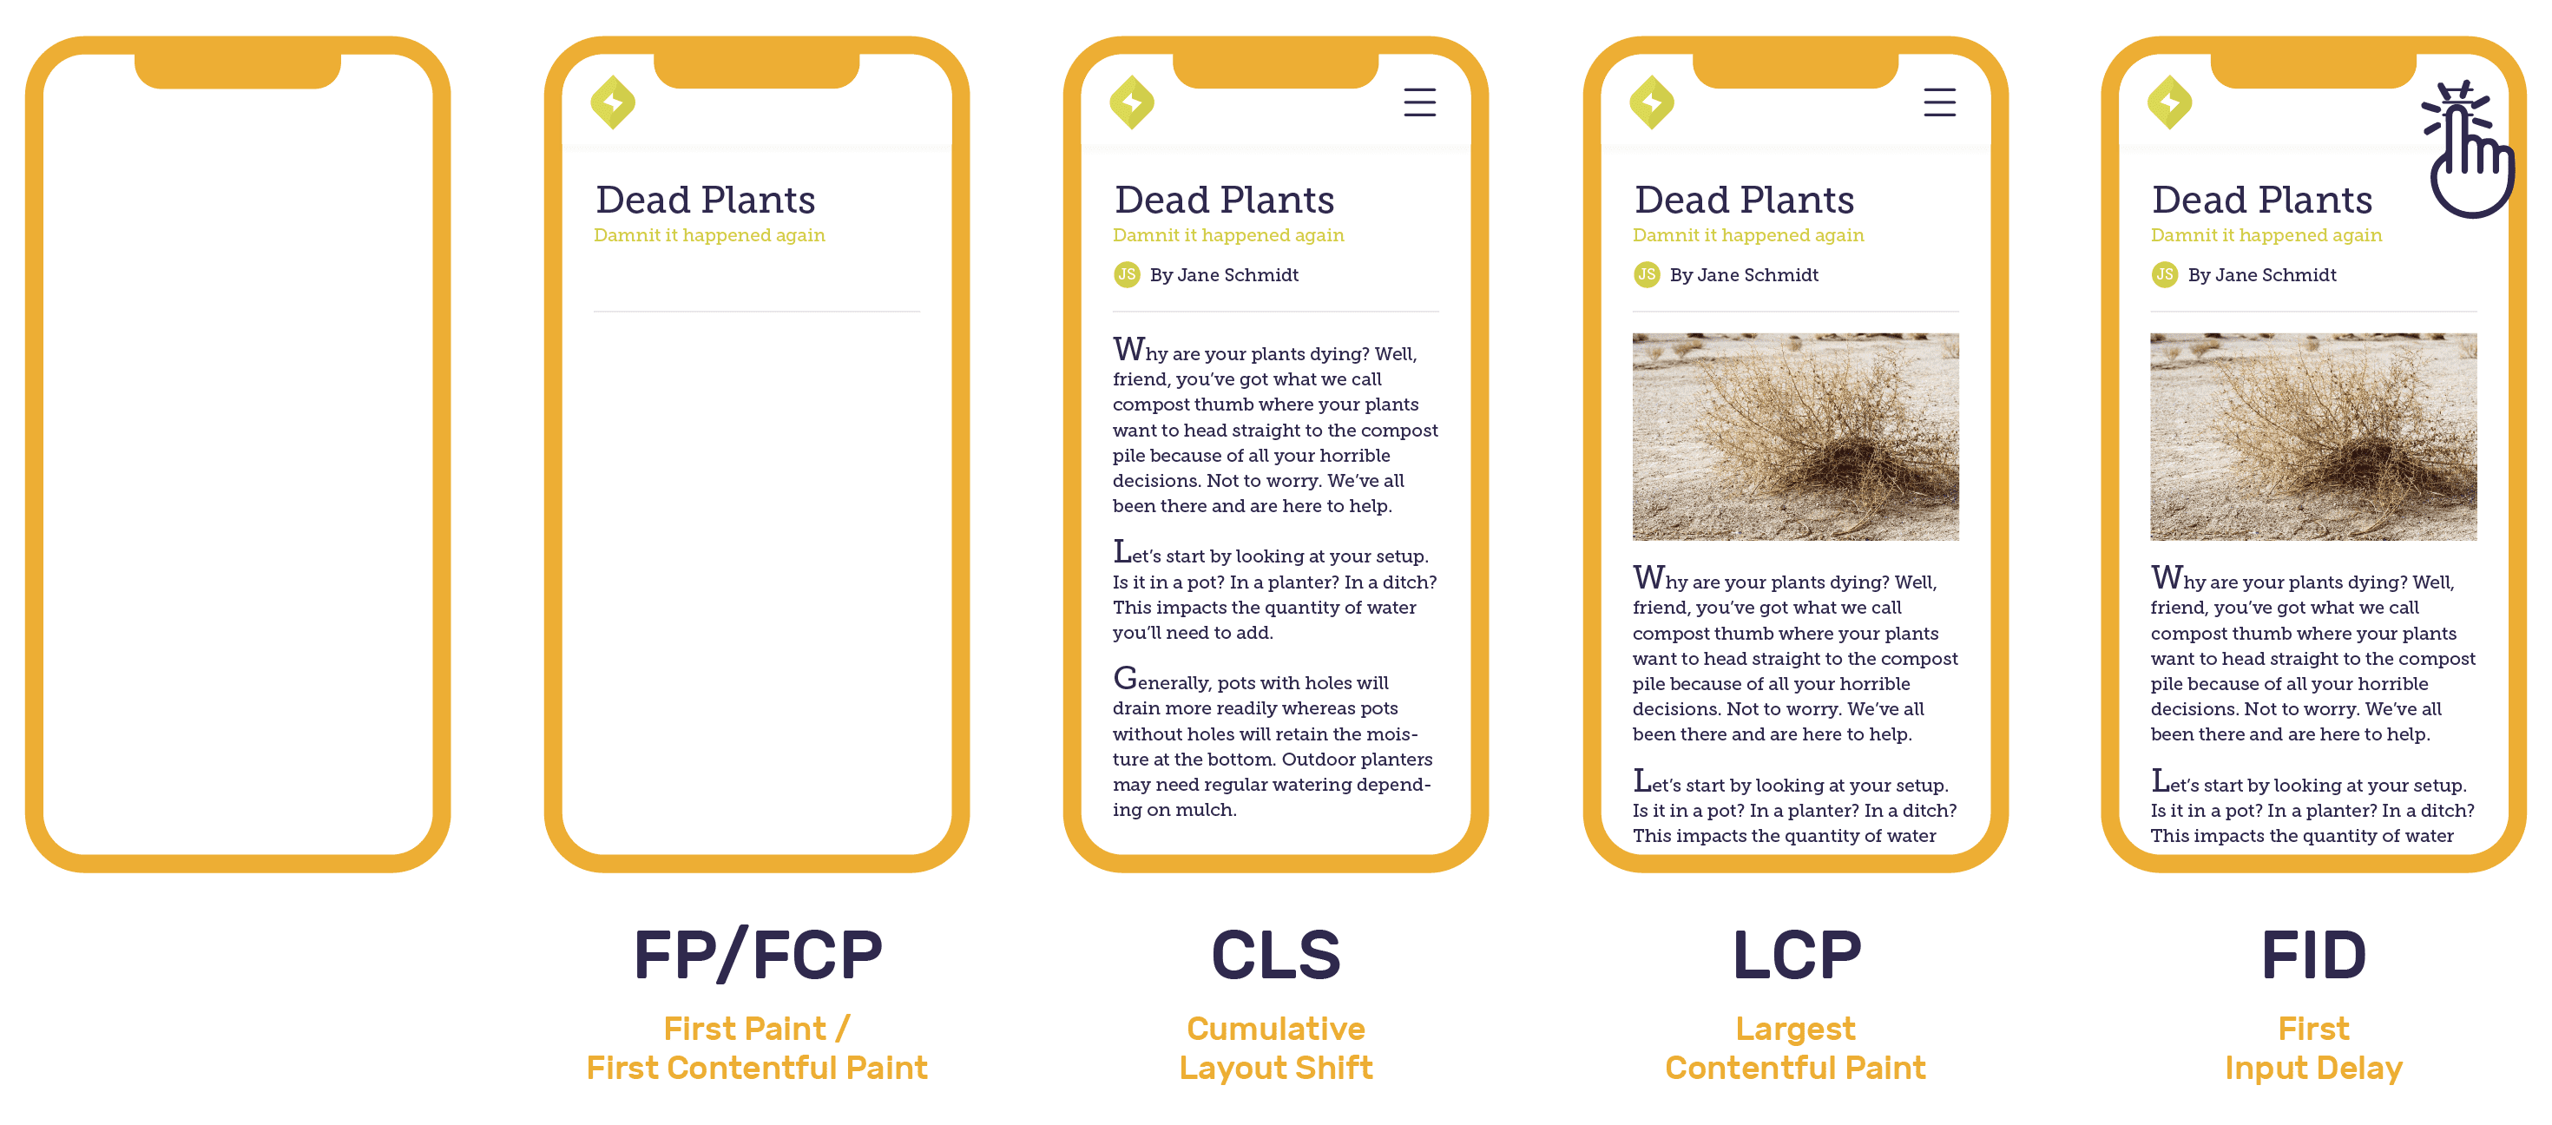
Comment savoir si mon dev est good?
Développer, Tester, Mesurer et Améliorer !

Slide 24
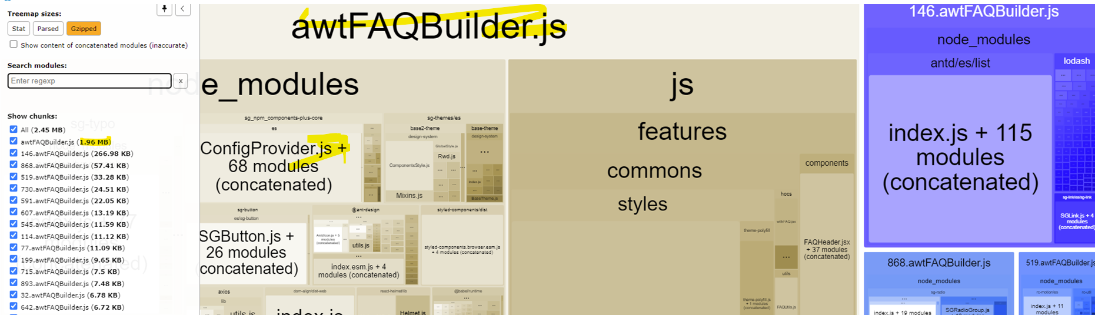
Comment savoir si mon dev est good?
La taille maximale du bundle recommandée en version gzip: 360 KB :
Développer, Tester, Mesurer et Améliorer !

Slide 25
Page et formulaire

Slide 26
Structure de la page
const HouseNpmLibDetailsView = ( lazy(() => ( import('../components/npm-lib/npm-lib-details/HouseNpmLibDetailsView') )) ); @withPageLayout({ pageTitle: 'Détails d\'une module npm', page: 'details-module-npm', }) class HouseNpmLibDetailsPage extends Component { // default props static defaultProps = { }; // propsType (validation) static propTypes = { }; componentDidMount() { } render() { const { onBackClicked, onOpenAwtDetailsClicked, } = this.props; const npmPackageName = decodeBase64UrlParam(paramByName(this.props)('an2000_npmPackageName')); return ( <Suspense fallback={<SGSpinner size="lg" />}> <HouseNpmLibDetailsView npmPackageName={npmPackageName} onBackClicked={onBackClicked} onOpenAwtDetailsClicked={onOpenAwtDetailsClicked} /> </Suspense> ); } } export default HouseNpmLibDetailsPage;
Dont’: Tout mettre dans la page.
Do: Page ensuite un composant de premier niveau (Abstraction Progressive).

Slide 27
Structure de la page
HouseNpmLibDetailsPage
HouseNpmLibDetailsView
HouseNpmInfosView
HouseNpmLibUsedOnView
Page
Composant de premier niveau (View)
Composant
(List, Table, Card, …)
HouseNpmLibImportedOnView
HouseNpmLibTimeline
UsedOnList
UsedOnListItem

Slide 28
page
// render view render() { const { configuration, recap, recapError, recapLoading, } = this.props || {}; // Log de debug éviter le erreurs lint de type "no-unused-vars" // tant que toutes les props ne sont pas réellement utilisées commonLog.debug('[SouCdgSummaryPage] render : display props', { configuration, recap, recapError, recapLoading, }); return ( <SouCdgSummaryView summary={recap} summaryError={recapError} summaryLoading={recapLoading} onCancel={this.onCancel} onValidate={this.onValidate} onPreviousStep={this.onPreviousStep} onCallback={openCallback} /> ); }
Composant de premier niveau

Slide 29

Composant de premier niveau
<> <FormStepper currentStepIndex={4} stepLabelList={[ SOU_CDG_SELECT_CARD_STEP_TITLE, SOU_CDG_PARAMETERS_STEP_TITLE, SOU_CDG_DELIVERY_ADDRESS_STEP_TITLE, SOU_CDG_RECAP_STEP_TITLE, ]} /> <SGTtitle level="2" > {words?.title} </SGTtitle> <SouCdgSummaryNewCardView summary={summary} /> <SouCdgSummaryCharacteristicsView characteristics={characteristics} characteristicsInfoMessage={characteristicsInfoMessage} /> <SouCdgSummaryDeliveryView adresse={adresse} /> <EtapeFooter isNextStepDisabled={false} onPreviousStep={() => onPreviousStep()} onNextStep={() => onValidate()} onCancel={() => setShowCancelPopin(true)} /> <SouCdgSummaryMentionsLegales summary={summary} /> </>
Composé de …

Slide 30
Etape footer
const EtapeFooter = ({ isNextStepDisabled, previousStepLabel, nextStepLabel, onNextStep, onPreviousStep, }) => ( <> <SGButton kind="ghost dark" onClick={onPreviousStep} > {previousStepLabel || btnRetourLabel} </SGButton > <SGButton onClick={onNextStep} disabled={isNextStepDisabled} > {nextStepLabel} </SGButton > </> );
Composé de …

Slide 31
utilisation d’un State dans la page
const HouseAwtDetailsView = LocalizedFragment(CommonsDico)(({ words, defaultAwt, awtTrigramme, awtRepositoryName, awtRepositoryBranchName, awtSelectedKeywords, awtSearchText, awtDefaultBranch, onBackClicked, onBranchChanged, }) => { const [ awt, setAwt, ] = useState({}); const [ currentTab, setCurrentTab, ] = useState('Frontend'); const [ currentHelpItem, setCurrentHelpItem, ] = useState(null);
Dont’: Utilisation d’un state dans la page.
Do: useState dans le composant de premier niveau.

Slide 32
Mélanger logique et affichage
<HouseAwtEvolutionsView testpath="../app/components/awt/HouseAwtEvolutionsView" evolutions={getFrontendEvolutions(awt)} onEvolutionClicked={onEvolutionClicked} />
<HouseAwtDependenciesView testpath="../app/components/awt/HouseAwtDependenciesView" dependencies={getFrontendDependencies(awt)} onDependencyClicked={onDependencyClicked} />
const HouseConfig = { TIMELINE_SETTINGS, HOUSE_DASHBOARD_DATASOURCE, HOUSE_BFF_URL, HOUSE_QUERY_CONFIG, HOUSE_QUERY_PAGE_SIZE, AWT_DETAILS_DEPS_FILTERS, exportAwtDataToCSV, isAwtReact, getFrontendDependencies, getFrontendEvolutions, getAwtStatsCategories, getAwtStatsSeriesByCategory, filterDependencies, buildBackUrlParams, buildAwtDetailsUrlParams, updateAwtStatsSeries, formatNpmPackageInfos, buildNpmDetailsUrlParams, exportNpmDataToCSV, }; export default HouseConfig;
Dont’: Formatter les données dans les composants.
Do: Utilisation des Configs et Utils (DRY).
Centralisation des constantes et des fonctions

Slide 33
Separation of concerns
Separation of concerns
A guiding principle when developing is Separation of Concerns. This principle asserts that software should be separated based on the kinds of work it performs. For instance, consider an application that includes logic for identifying noteworthy items to display to the user, and which formats such items in a particular way to make them more noticeable. The behavior responsible for choosing which items to format should be kept separate from the behavior responsible for formatting the items, since these behaviors are separate concerns that are only coincidentally related to one another.
Architecturally, applications can be logically built to follow this principle by separating core business behavior from infrastructure and user-interface logic. Ideally, business rules and logic should reside in a separate project, which should not depend on other projects in the application. This separation helps ensure that the business model is easy to test and can evolve without being tightly coupled to low-level implementation details (it also helps if infrastructure concerns depend on abstractions defined in the business layer). Separation of concerns is a key consideration behind the use of layers in application architectures.
https://learn.microsoft.com/en-us/dotnet/architecture/modern-web-apps-azure/architectural-principles

Slide 34
Container/Presentational Pattern
Presentational Components: Components that care about how data is shown to the user.
A presentational component receives its data through props.
Its primary function is to simply display the data it receives the way we want them to, including styles, without modifying that data.
Container Components: Components that care about what data is shown to the user.
The primary function of container components is to pass data to presentational components, which they contain.
Container components themselves usually don't render any other components besides the presentational components that care about their data. Since they don't render anything themselves, they usually do not contain any styling either.
https://www.patterns.dev/posts/presentational-container-pattern/

Slide 35
Domaine pure
saga
redux
pages
Components (pure domain)
services
Leveraging Hexagonal Architecture
We needed to support the ability to swap data sources without impacting business logic, so we knew we needed to keep them decoupled. We decided to build our app based on principles behind Hexagonal Architecture.
The idea of Hexagonal Architecture is to put inputs and outputs at the edges of our design. Business logic should not depend on whether we expose a REST or a GraphQL API, and it should not depend on where we get data from — a database, a microservice API exposed via gRPC or REST, or just a simple CSV file.
The pattern allows us to isolate the core logic of our application from outside concerns. Having our core logic isolated means we can easily change data source details without a significant impact or major code rewrites to the codebase.
One of the main advantages we also saw in having an app with clear boundaries is our testing strategy — the majority of our tests can verify our business logic without relying on protocols that can easily change.
https://netflixtechblog.com/ready-for-changes-with-hexagonal-architecture-b315ec967749

Slide 36
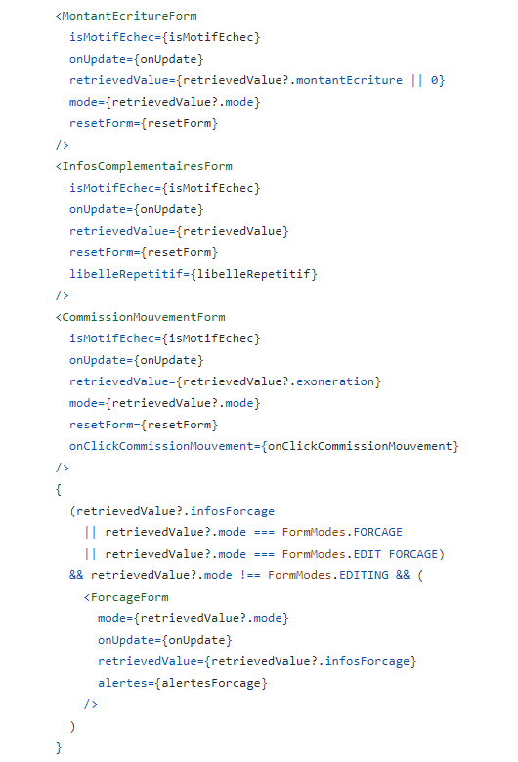
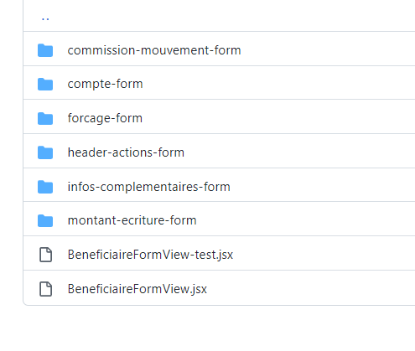
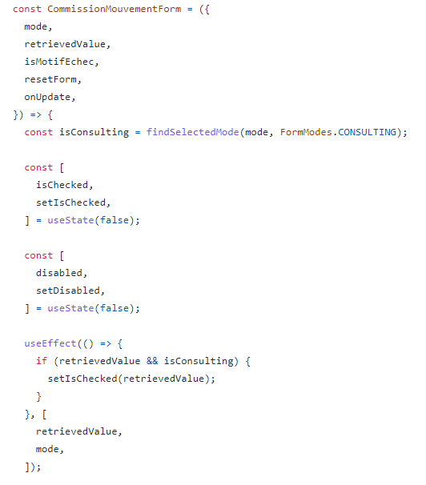
formulaire
OK
Dont’: Faire un grand formulaire.
Do: Splitter, Localiser le state et lazy load si nécessaire.
https://sgithub.fr.world.socgen/obea/bddf_awt_utr/blob/develop/modules/front-js/js/features/vie/beneficiaire/components/beneficiaire-form-view-container/beneficiaire-form/BeneficiaireFormView.jsx#L112

Slide 37
Usestate vs formik
Pour des raisons de performances, il est recommandé d'attacher un useState à chaque composant dynamique de formulaire plutôt que d'avoir un seul state.
Si la logique de validation de formulaire est complexe, il est recommandé d'externaliser la logique de validation dans un utilitaire (exemple) ou d'utiliser une solution basée sur Formik et Yup.
L'utilisation de Redux-Form n'est pas recommandée.
http://xblocks.socgen/icd/demo/#/client/awt-react-formulaire-plusieurs-etapes.md

Slide 38
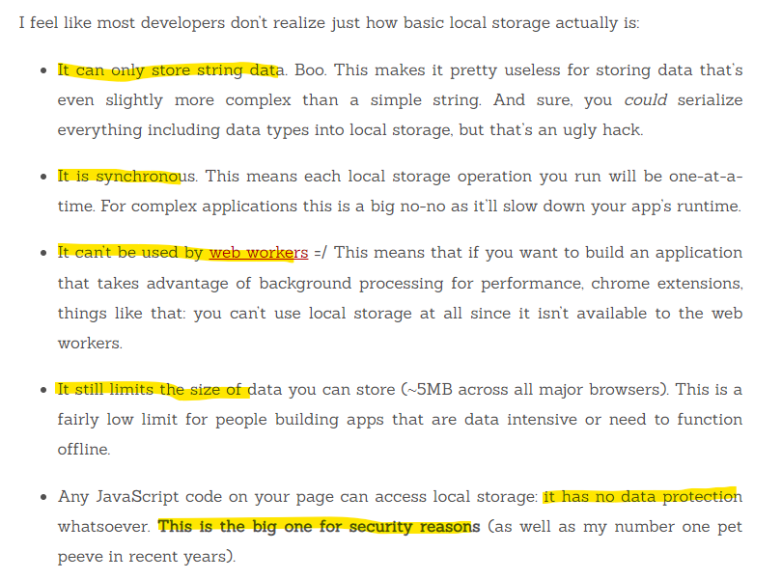
Formulaire: Sauvegarde des étapes intermédiaires
Dont’: Il n'est pas recommandé d'utiliser localStorage, cookie ou de stocker côté navigateur en général.
Do: Persister au niveau du cache BFF.
Stop Using Local Storage
http://xblocks.socgen/icd/demo/#/client/awt-react-formulaire-plusieurs-etapes.md

Slide 39
Logique commune
const withPageLayout = ({ pageTitle, page, hasBackButton = true, }) => (WrappedComponent) => { @withThemeProvider() class PageLayout extends Component { // default props static defaultProps = {}; // propsType (validation) static propTypes = {}; componentDidMount() { }
Dont’: Duplication de code.
Do: Utilisation des HOCs, Config et Utils.
@withPageLayout({ pageTitle: 'Tableau de bord', page: 'dashboard', hasBackButton: false, }) class HouseDashboardPage extends Component { componentDidMount() {}
@withPageLayout({ pageTitle: 'Liste des AWT Web', page: 'list-awt', }) class HouseAwtPage extends Component { // default props static defaultProps = { defaultAwtList: [], defaultAwtStats: [], onBackClicked: null, onOpenAwtDetailsClicked: null, onMenuChanged: null, };

Slide 40
Side effects

Slide 41
DON’T: Lecture immédiatE d’un State
OK
KO
<HouseAwtListItem testpath="../app/components/awt/HouseAwtListItem" awt={awt} onOpenAwtDetailsClicked={onOpenAwtDetailsClicked} onSearchTextChanged={(searchText) => { setAwtSearchText(searchText); }} />
onSearchTextChanged={(searchText) => { setAwtSearchText(searchText); // refetch de la site directement refetchAwtList?.({ offset: 0, limit: HOUSE_QUERY_PAGE_SIZE, keywords: awtKeywords || [], searchText: awtSearchText, }); }}
useEffect(() => { refetchAwtList?.({ offset: 0, limit: HOUSE_QUERY_PAGE_SIZE, keywords: awtKeywords || [], searchText: awtSearchText, }); }, [ awtKeywords, awtSearchText, ]);
React may batch multiple setState() calls into a single update for performance.
Because this.props and this.state may be updated asynchronously, you should not rely on their values for calculating the next state.
https://reactjs.org/docs/state-and-lifecycle.html#state-updates-may-be-asynchronous

Slide 42
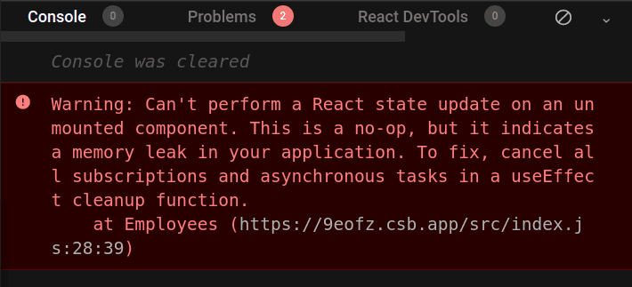
DON’T: setTimeout et setInterval sans clean
const MonComposant = () => { const [ count, setCount, ] = useState(0); useEffect(() => { const timer = setTimeout(() => { setCount('Timeout called!'); }, 1000); return () => clearTimeout(timer); }, []); return ( <span> Current Count: {count} </span> ); }; export default MonComposant;
const MonComposant = () => { const [ countInterval, setCountInterval, ] = useState(0); useEffect(() => { const interval = setInterval(() => { setCountInterval(countInterval + 1); }, 1000); return () => clearInterval(interval); }, []); return ( <span> Current Count: {countInterval} </span> ); }; export default MonComposant;

Slide 43
DON’T: addEventListener sans clean
class MyComponent extends React.Component { constructor(){ super(props) this.handleClick = this.handleClick.bind(this) } handleClick = () => { //do something when we clicked } componentDidMount() { document.addEventListener("mousedown", this.handleClick); } componentWillUnMount() { document.removeEventListener("mousedown", this.handleClick); } render() { renturn ... } } export default MyComponent
import React, { useEffect, } from 'react'; const MonComposant = () => { const handleKeyDown = (event) => { console.log('A key was pressed', event.keyCode); }; useEffect(() => { window.addEventListener('keydown', handleKeyDown); // cleanup listener return () => { window.removeEventListener('keydown', handleKeyDown); }; }, []); return ( <span> Hello ! </span> ); }; export default MonComposant;
https://github.com/facebook/react/issues/12947

Slide 44
DON’T: Appel Async dans un Composant Fonctionnel
Utilisation de Redux et Saga.
Clean-effect n’est pas suffisant pour un appel asynchrone.
Il n’y a pas un mécanisme natif pour annuler une Promise une fois lancée (AbortController est récent et non encore tester avec React).
const [isVisible, setIsVisible, ] = useState(true); useEffect(() => { let cancel = false; someAsyncFunction().then(() => { if (cancel) return; setIsVisible(false); }); return () => { cancel = true; }; }, []);

Slide 45
DON’T: Routage dans un Composant Fonctionnel
import React from 'react'; import { NavigationUtils, } from 'awt-react-extras'; const { navigateToPage, } = NavigationUtils; const MonComposant = () => ( <> <span> Hello ! </span> <button onClick={() => { navigateToPage( { history, }, url, null, null, false ); }} /> </> ); export default MonComposant;
import React from 'react'; const MonComposant = ({ onValidateClicked, }) => ( <> <span> Hello ! </span> <button onClick={() => onValidateClicked()} /> </> ); export default MonComposant;
La pagination doit être au niveau de la page et un callback est passé dans les props du composant (les composants doivent rester pure).

Slide 46
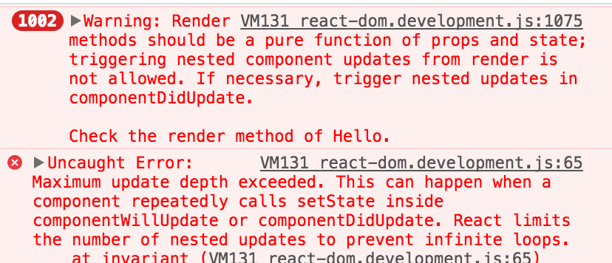
DON’T: Déclencher un side effect dans le render
Le routage ne doit pas être fait au niveau de render.
L’appel aux services http ne doit pas être fait au niveau du render.
Il faut plutôt exploiter componentDidUpdate ou componentDidMount.
http://xblocks.socgen/icd/demo/#/client/awt-react-formulaire-plusieurs-etapes?id=phase-3-prise-en-compte-du-r%c3%a9sultat-de-la-soumission-du-formulaire-1

Slide 47
React & performances

Slide 48
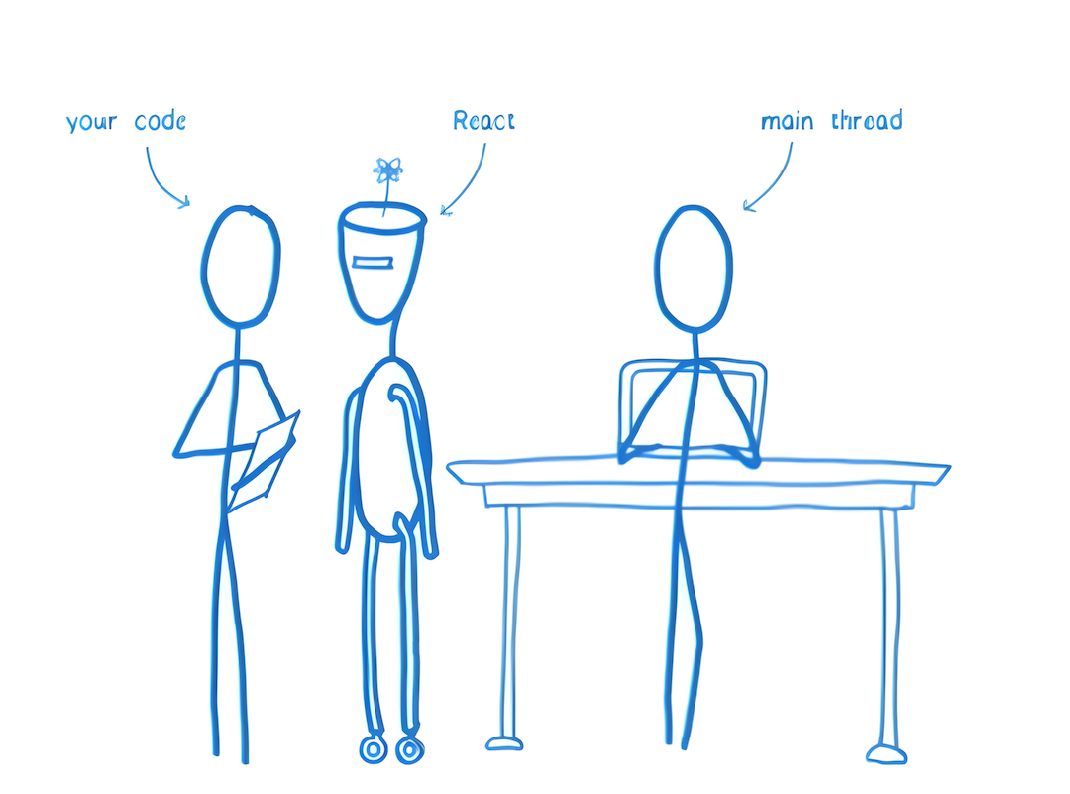
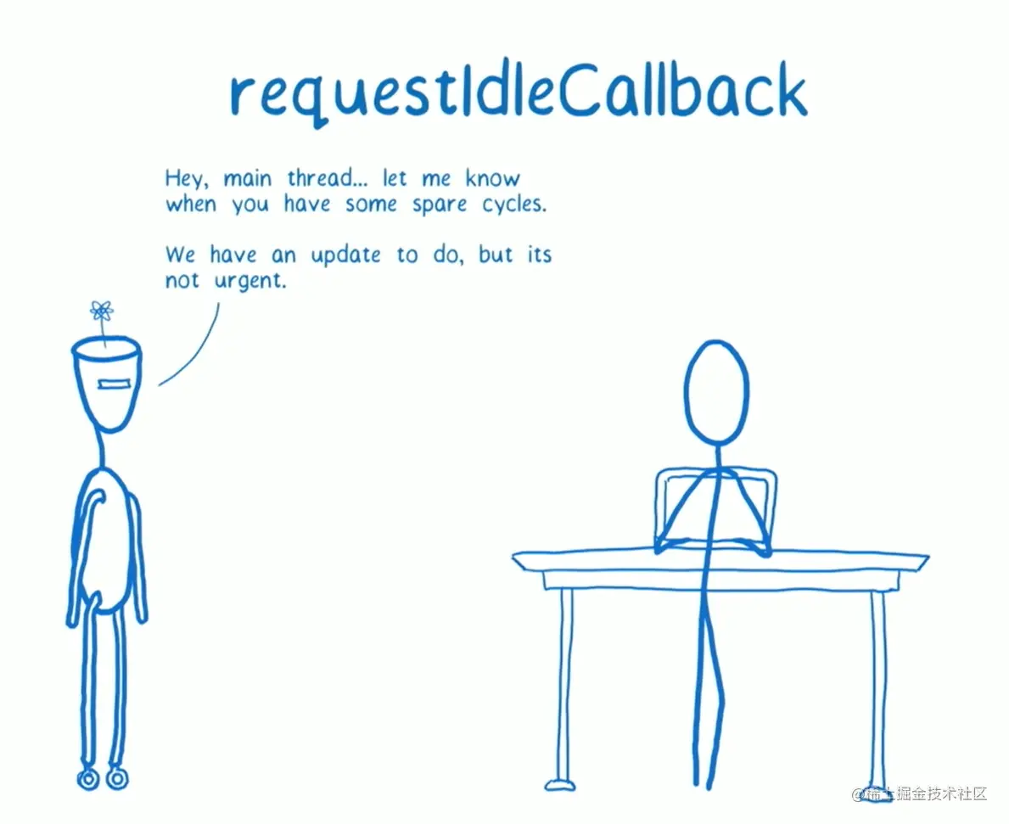
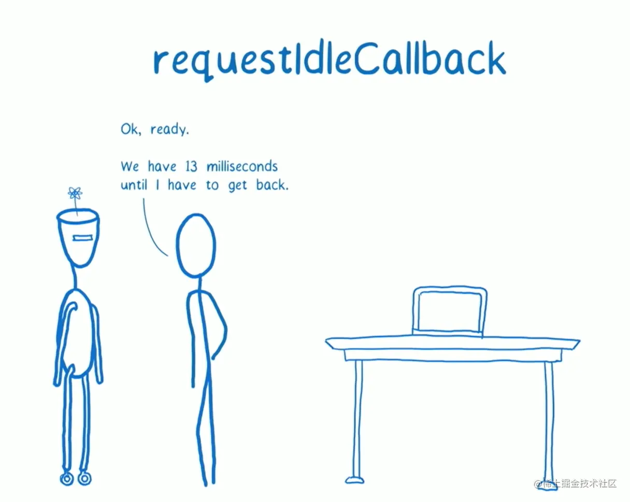
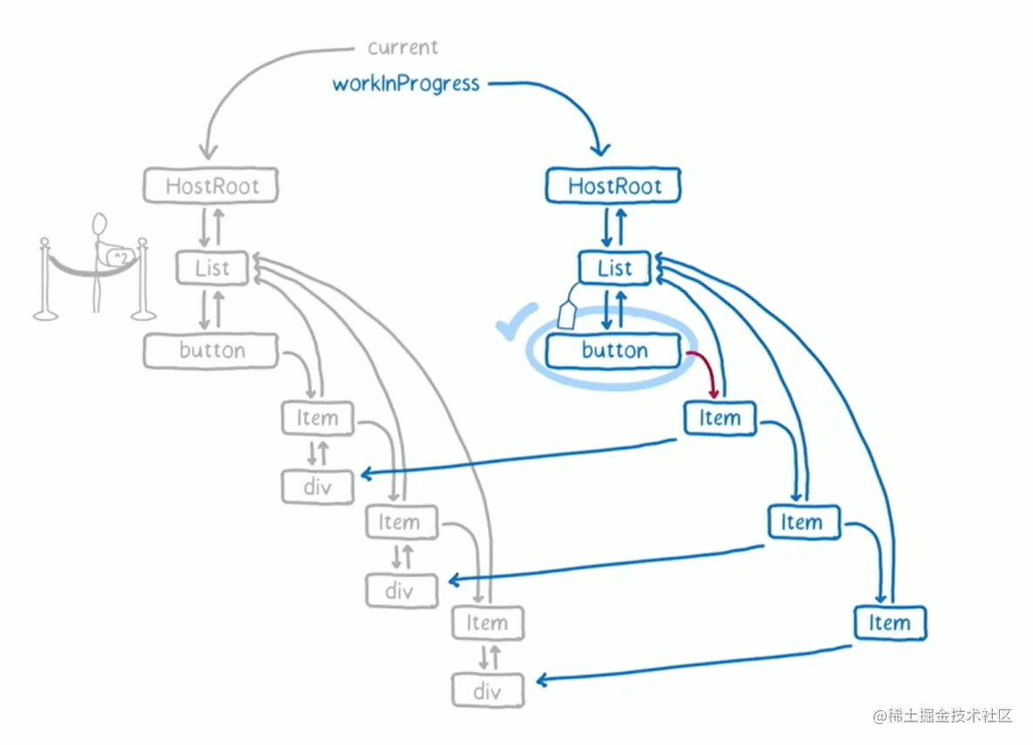
Attention !
Il ne faut pas toucher le DOM.
“The main control of the program was inverted, moved away from you to react.”

Slide 49
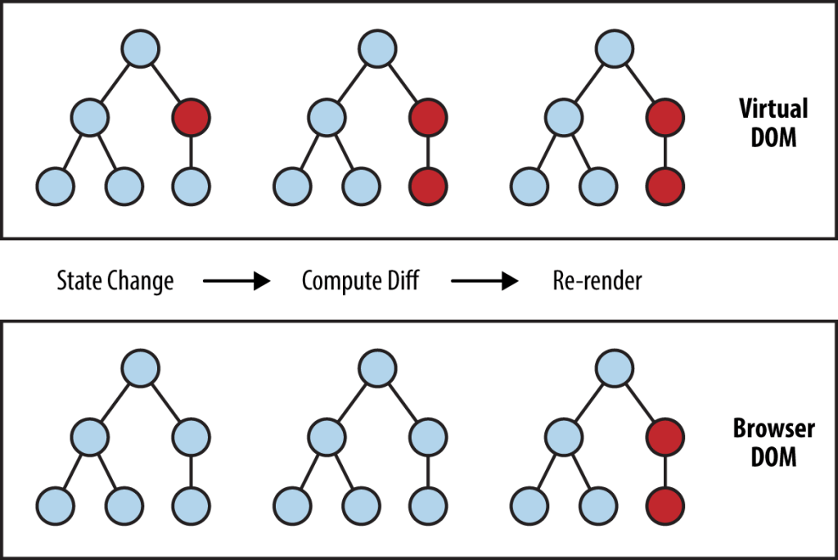
Attention !
Il ne faut pas toucher le DOM.
Réconciliation
Render
“The main control of the program was inverted, moved away from you to react.”

Slide 50

Attention !
Il ne faut pas toucher le DOM.

Slide 51
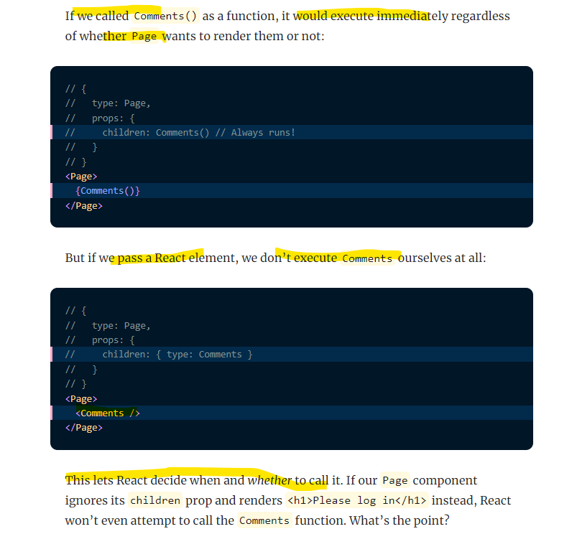
DON’T: Appel d’un composant sous forme de fonction
http://xblocks.socgen/icd/demo/#/client/awt-react-optimisation-webpack?id=a-d%c3%a9claration-et-appel-des-composants-react-lazy-evaluation
https://overreacted.io/react-as-a-ui-runtime/#lazy-evaluation

Slide 52
List & Index
// good const todoItems = todos.map((todo) => <li key={todo.id}> {todo.text} </li> ); // bad const todoItems = todos.map((todo, index) => <li key={index}> {todo.text} </li> ); // good <li key={item.id}>{item.name}</li> // bad <li key={v4()}>{item.name}</li> // bad <li key={Math.random()}>{item.name}</li> // bad <li key={index}>{item.name}</li>
Il n'est pas recommandé d'utiliser des key aléatoires, random() ou la librairie uuid (v4()).
Il n'est pas recommandé d'utiliser les index comme des keys.

Slide 53
DON’T: Abuser l’utilisation du dangerouslySetInnerHTML
dangerouslySetInnerHTML doit être le cas particulier.
La chaîne html passée doit être purifiée avec DOMPurify.
React est déclarative.

Slide 54
DON’T: Abuser l’utilisation de useRef
There are a few good use cases for refs:
Avoid using refs for anything that can be done declaratively.
React est déclarative.
Managing focus, text selection, or media playback.
Triggering imperative animations.
Integrating with third-party DOM libraries.
https://en.reactjs.org/docs/refs-and-the-dom.html#dont-overuse-refs

Slide 55
DON’T: Utilisation de « data.map » pour tous les cas de liste
Tout dépend de la quantité des données à afficher.
Si la quantité des données est limité en PROD ( <= 10 éléments), map peut être utilisé.
Si la quantité de données dépasse 10 éléments, ces techniques sont à privilégier :
SGList avec Load more
SGList ou SGTable avec pagination
SGList Infinite (windowing)
https://socle.applis.bad.socgen/icd/static/sg-components-plus/latest/?path=/docs/2-0-avenir-2-4-molecules-sglist-listcomplexe-listafficherplus--list-afficher-plus

Slide 56
Qualité de code

Slide 57
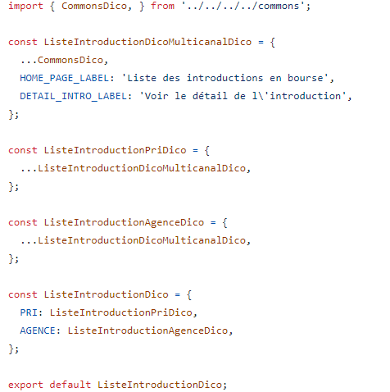
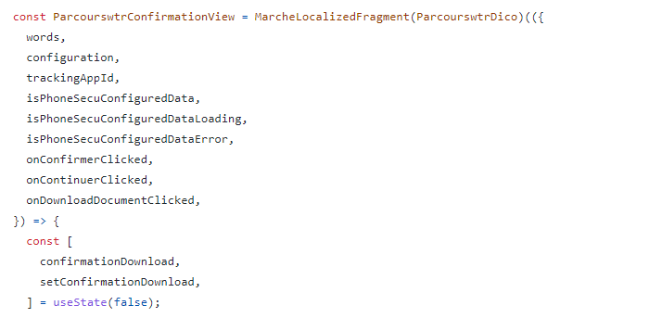
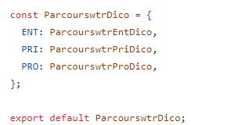
DON’T: Wording sans dico
http://xblocks.socgen/icd/demo/#/client/awt-react-localization-simple.md
http://xblocks.socgen/icd/demo/#/client/awt-react-localization-marche.md

Slide 58
DON’T: des Noms (variable, fonction, composant, …) sans contexte
Rôle fonctionnel + Rôle Technique
En cas de refactoring, on limite les régressions.
Self documented code.
Les noms doivent être contextualisés (bounded context).
Les noms vont servir comme des mots clés pour facilement retrouver la partie du code.
Il n’est pas recommandé d’utiliser des mots réservés dans les noms: global, force, function, GET, POST, ...
Les actions html doivent être de la forme: on[target][type].
ViperSuiviTable
ViperSuiviTableRow
ViperSaisieForm
ParClasseursList
ViperEditService
ViperDeleteService
ViperSuiviService
ViperDetailsService
ViperHabilitationSaisieService
ViperSuiviPage
http://xblocks.socgen/icd/demo/#/client/awt-react-clean-code-normes.md

Slide 59
Do: utilisation des awt-react-cli
Les cli incluent les bonnes pratiques de nomenclature.
Les cli incluent les bonnes pratiques d’organisation.
Les cli permettent de créer les services automatiquement branchés à Redux et Saga.
Les cli génèrent des routes « lazy » automatiquement.
https://sgithub.fr.world.socgen/SocleDigitalClient/sg_npm_dgt_awt_react-cli

Slide 60
Do: lire la documentation socle et suivre la check-list react
Vous pouvez intégrer la check-list dans vos pull request ☺
https://sgithub.fr.world.socgen/AppliDigitalClient/sg_npm_sgc_components-plus/blob/develop/.github/pull_request_template.md
http://xblocks.socgen/icd/demo/#/client/awt-v4-react-checklist.md

Slide 61
A ne pas oublier !

Slide 62
Points importants
Split des grands composants et des grands formulaires
Abstraction progressive : page => view => reste
Opportunités pour introduire Suspense & Lazy
Localisation du state au niveau des composants (éviter le state dans la page)
Clean des effects (timer, interval, event listeners)
Les appels Async doivent se faire via Redux et Saga
Formulaire: useState vs Formik
Formulaire: sauvegarde des étapes intermédiaires dans le cache BFF
Bonnes pratiques React
Don’t Touch The DOM
Qualité du code

Slide 63
tips
Ajouter une fonctionnalité
Tester
Mesurer
Commit & Push
Revue de code
avancement incrémental

Slide 64
Bonne pratique
Correcte
Clean
Performant
amélioration incrémental

Slide 65
bonus
Confluence
Documentation
Une seule façon pour expliquer le projet
Charte de développement

Slide 66
Merci beaucoup !
A vous de jouer maintenant !

